Slide 1
Motion Matching
A Data Driven Animation Approach

Slide 2
Kan XU: Gameplay programmer from Naughty Dog.
Projects:
The Last of Us Part II
Uncharted: The Lost Legacy
Uncharted 4: A Thief’s End
The Last of Us Remastered
The Last of Us Ps3
The Last of Us: Left Behind

Slide 3
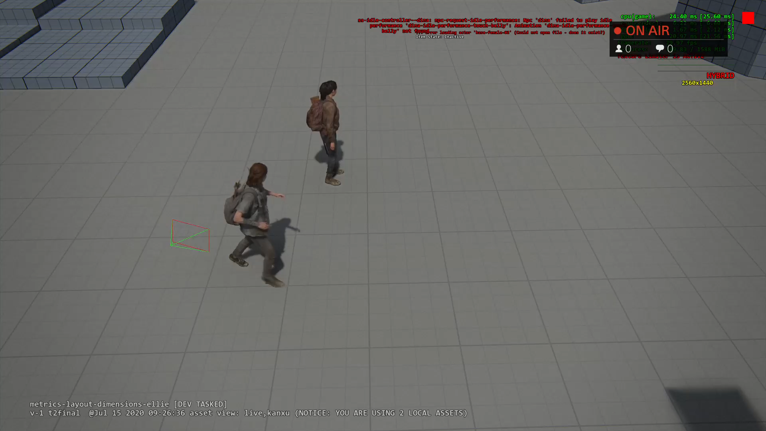
Strafing MM Demo
Notes:
Let’s first see what motion matching can do:
TLOU2 is a 3rd person shooter game. Main character is always strafing.
This is our main character Ellie’s explore motion matching set:

Slide 4
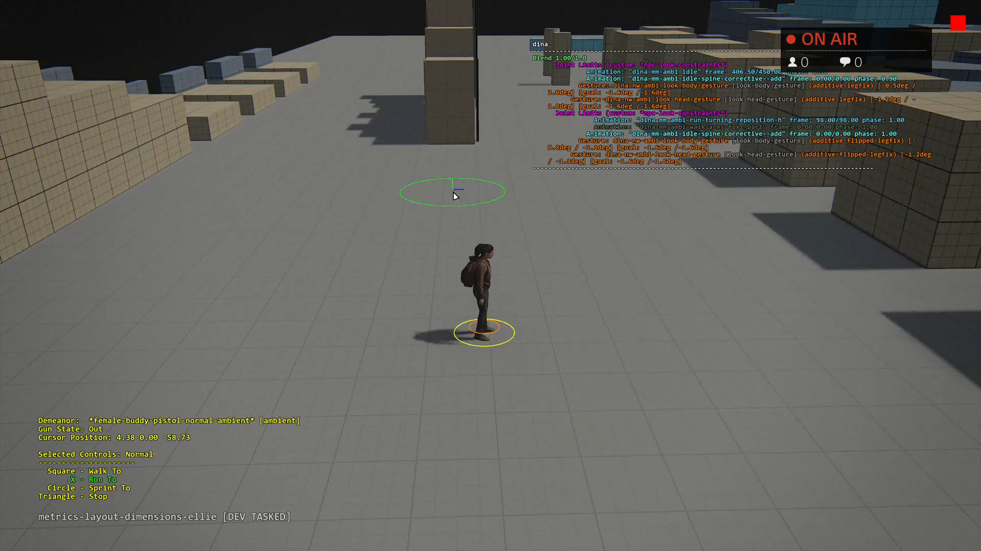
Non Strafing MM Demo
Notes:
Of course we can apply motion matching to non strafing movement.
This is Dina. You can see a lot of foot planting, weight shifting here.

Slide 5
Traditional locomotion system
Blend tree and parametric blending
Many layers
State machines
Phase matching
Notes:
Let’s first look at traditional locomotion system:
TODO: 1) Add screenshot of traditional state machine 2) add blend tree.

Slide 6
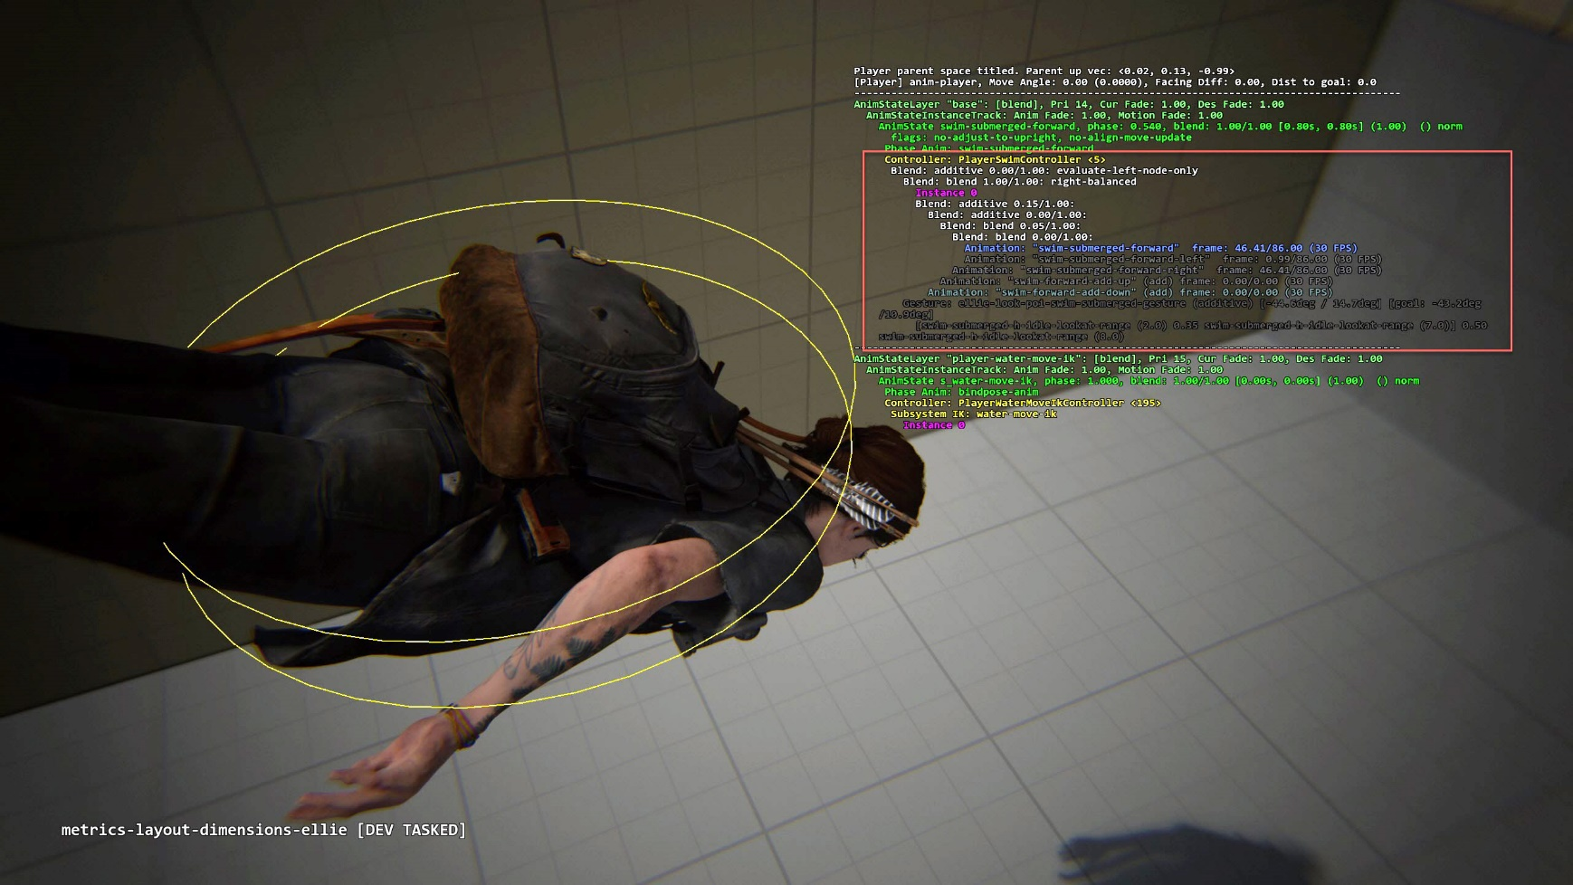
Blend tree and parametric blending

Slide 7
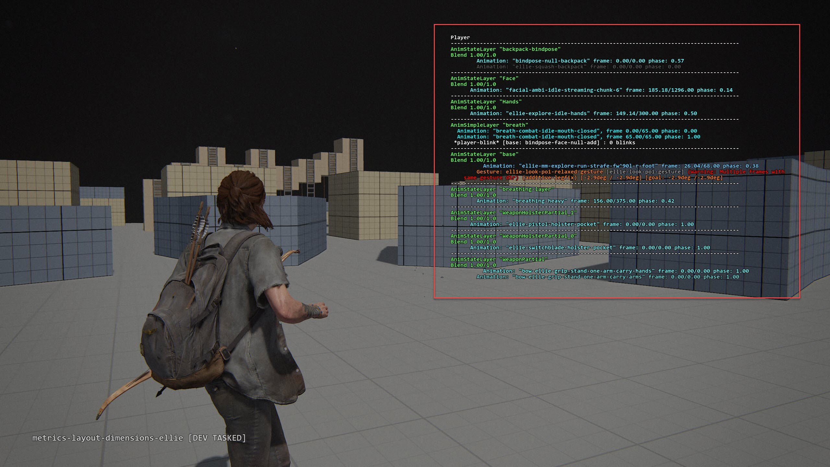
Layering

Slide 8
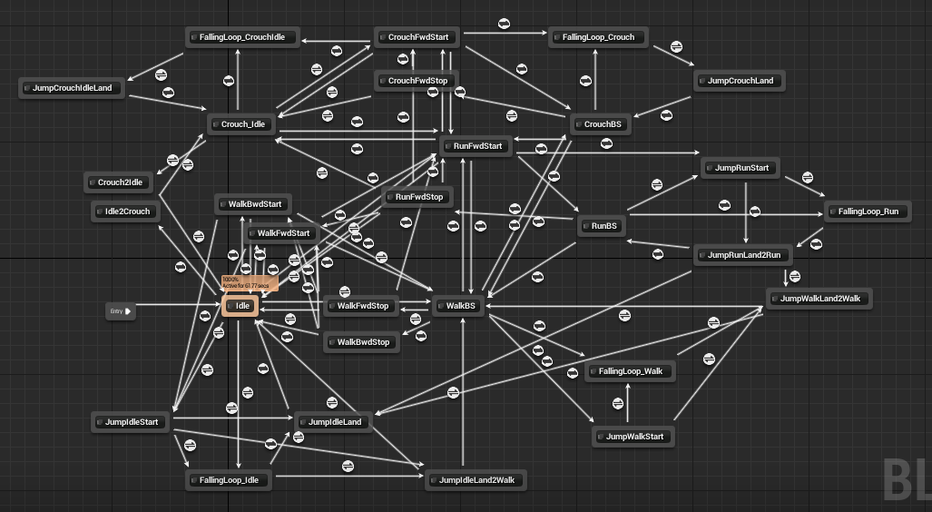
Animation State Machine
Notes:
A picture of unreal locomotion state machine. We can see it’s a web of states.

Slide 9
Phase matching
Animator need do a lot tagging.

Slide 10
Drawback of traditional system
Code: Complexity
Huge web of state-machine
Lots of layers
Hard to implement transitions (lose fidelity)
Animation:
Lots of markup for phase matching

Slide 11
Motivation
There’s details presented in data:
Change directions
Foot planting
Weight shifting
Those details are hard to implemented by traditional methods.
Even implemented, it loses fidelity to some degrees.
Notes:
Usually those special events are implemented by adding a new state. With some parametric blending: left and right additives.

Slide 12
Motivation (cont.)
Let’s forget about state machines, blend trees.
Why not think mocap data as a pose database, and search the best matching pose from it?
Notes:
Given player’s input, try find the best matching pose.

Slide 13
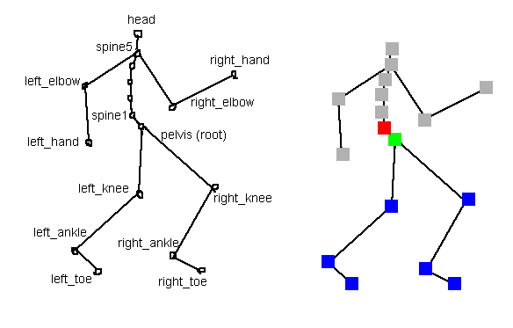
Terminology
Animation Rig
Animated Hierarchy
Root
Notes:
Before getting to motion matching algorithm, let’s first define the terminology.

Slide 14
First idea: Match desired trajectory
For each animation, it has a root trajectory
Each pose in animation can look ahead and back to get root trajectory
Gameplay can provide a desired trajectory
For player, we can convert joypad input to trajectory
For NPC, his navigation path is desired trajectory naturally

Slide 15
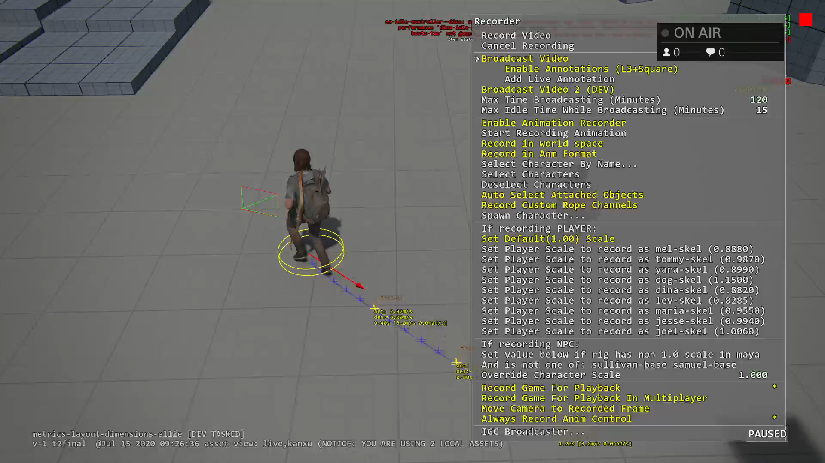
Desired trajectory from gameplay
Gameplay codes can generate a desired trajectory

Slide 16
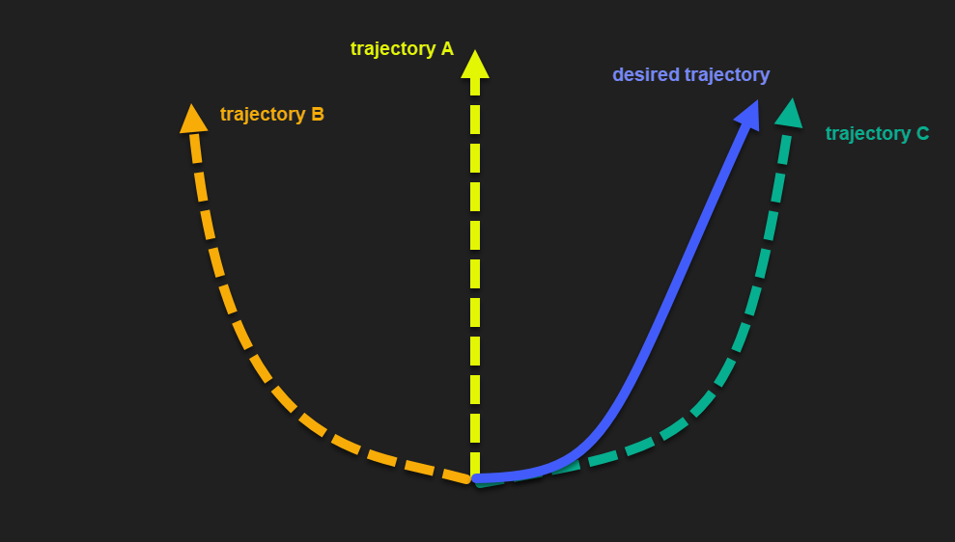
Matching Trajectory Curves
Given the trajectory of any animation clip, we can calculate its “distance” between the desired trajectory.

Slide 17
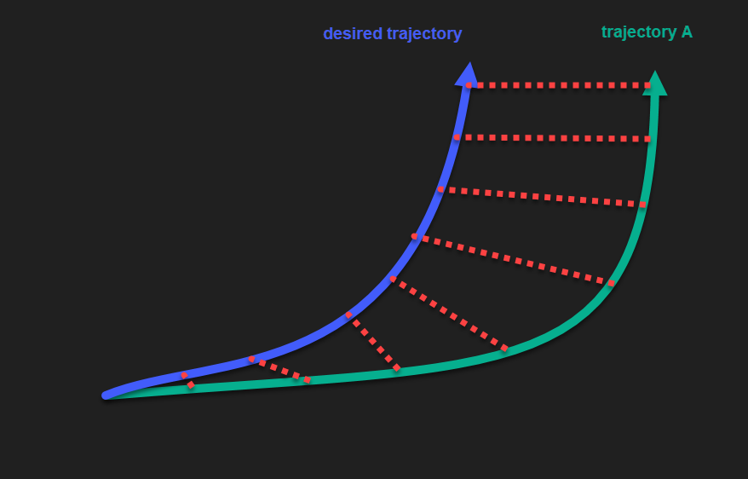
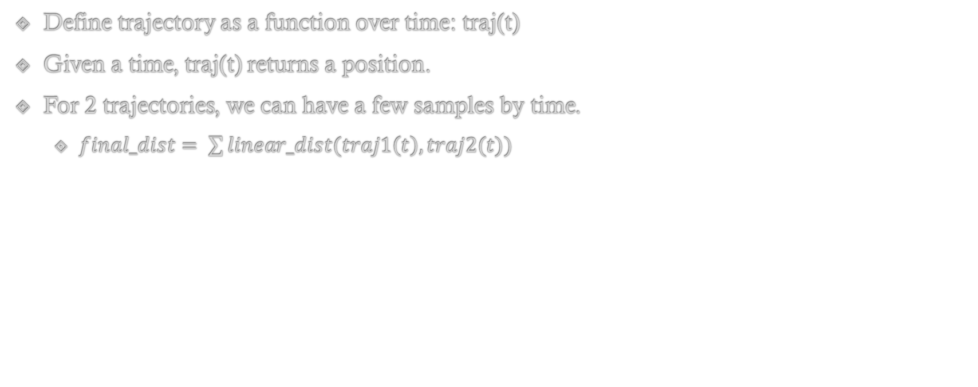
“Distance” between 2 Trajectories
Define trajectory as a function over time: traj(t)
Given a time, traj(t) returns a position.
For 2 trajectories, we can have a few samples by time.
$final_dist= \sum{linear_dist(traj1\left(t\right), traj2(t))}$

Slide 18
First algorithm
Given player explore locomotion set:
183 animations
8866 poses
First algorithm:
for pose in all_poses:
{
dist = calc_dist(desired_trajectory, pose_trajectory);
if (dist < best_dist)
best_dist = dist;
}
play the best_dist pose.

Slide 19
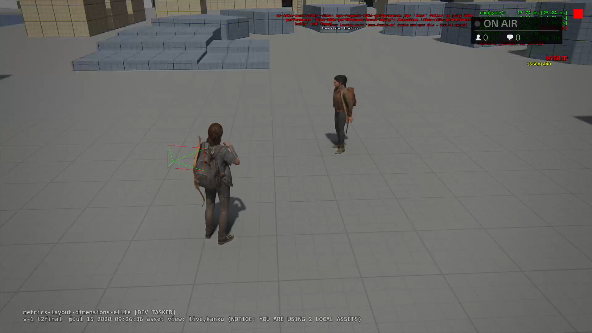
Result of matching desired trajectory only

Slide 20
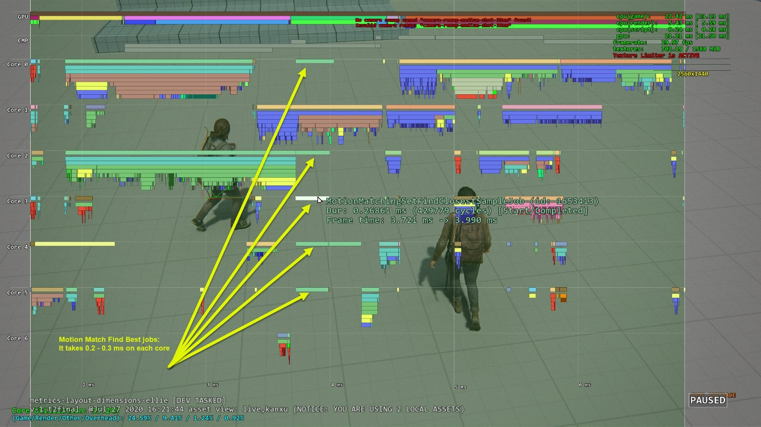
Performance of brute force algorithm

Slide 21
We have problems
Matching trajectory only doesn’t play transition at all.
Brute force algorithm is expensive:
With 8866 poses trajectories calculated at loading time and cached.
It takes 0.3ms on each core for one character.
It scales up linearly by number of characters.

Slide 22
“Pose” Matching
We need also add “pose” into consideration.
The new measurement is:
How good a “candidate pose” matches character current pose
+
How good a pose’s trajectory matches the desired trajectory

Slide 23
Pose Matching
A pose is a list of joints. Each joint has 2 key features:
Position
Velocity
Pose difference can be defined:
Dist(PoseA.Pos, PoseB.Pos) * Weight_Pos + Dist(PoseA.Vel, PoseB.Vel) * Weight_Vel
We don’t need compare all joints, we just need most relevant joints:
L_ankle, R_ankle, Spine for biped locomotion
Joint info are usually saved in local space. But pose matching should be done in global space.

Slide 24
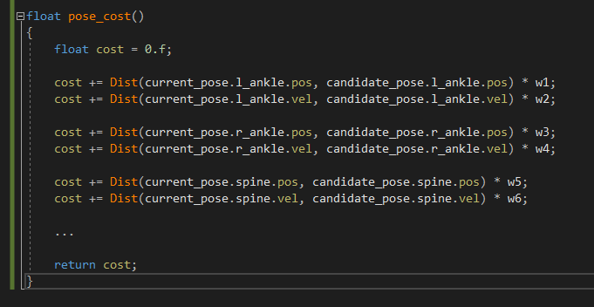
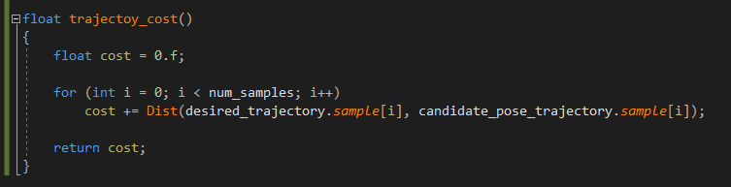
Second Algorithm
Trajectory cost and pose matching cost are different units:
Need a weight to combine them
Second algorithm:
for pose in all_poses:
{
dist_traj = calc_dist(desired_trajectory, pose_trajectory);
dist_pose = calc_pose(current_pose, candidate_pose);
dist = dist_traj * w_trajectory + dist_pose * w_pose;
if (dist < best_dist)
best_dist = dist;
}

Slide 25
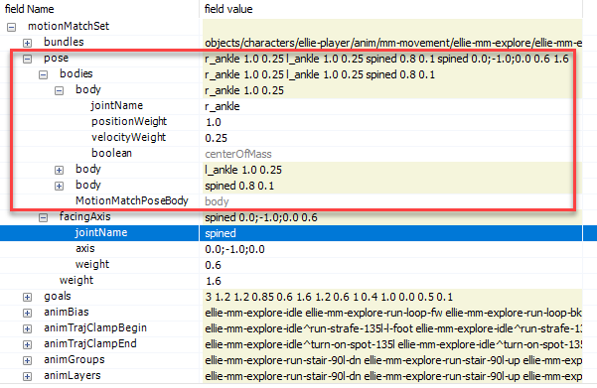
Pose weights

Slide 26
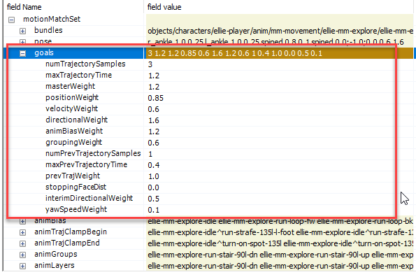
Trajectory weights

Slide 27
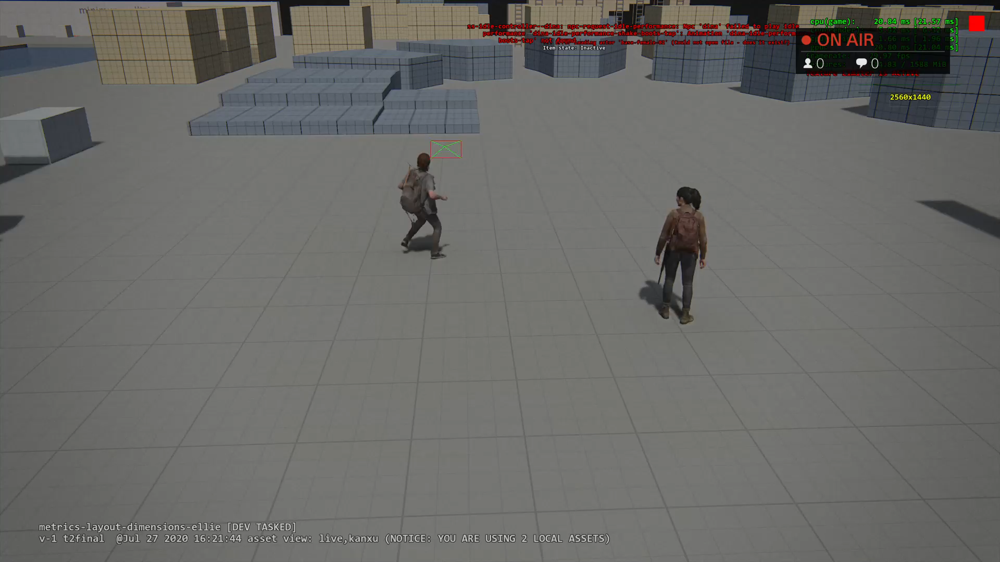
Result of pose matching

Slide 28
Optimization
Brute force search all candidate poses are bad.
First Idea: Run cost function on GPU:
Compute shader to compute cost.
Another shader to reduce and find the best match.
Downside:
Kick compute job onto GPU has latency.
MM needs be finished before animating character at the same frame.
Notes:
Kick compute job onto GPU has latency:
We actually have many jobs, the key is to use the result next frame.
mesh raycaster for bullet, character feet IK.
AI exposure map: to get how much npc can see around player.

Slide 29
Look at the data
Each Pose:
3 joints (l_ankle, r_ankle, spine) + 1 facing direction.
(3 * (kPosCount + kVelCount)) + kFacingCount => 21 floats
4 trajectory samples:
(4 * (kPosCount + kVelCount + kFacingCount + kYawSpeedCount)) => 40 floats
Each pose is 61 dimension vector.
Notes:
Npc has the same dimension.

Slide 30
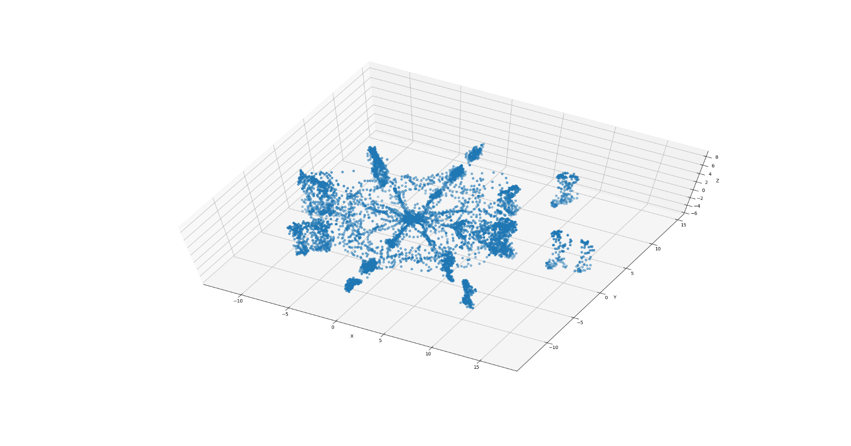
Look at the data
Notes:
8866 poses
Each point is a pose: 61 dimension vectors.
For visualization purpose, use PCA to reduce dimension to 3.

Slide 31
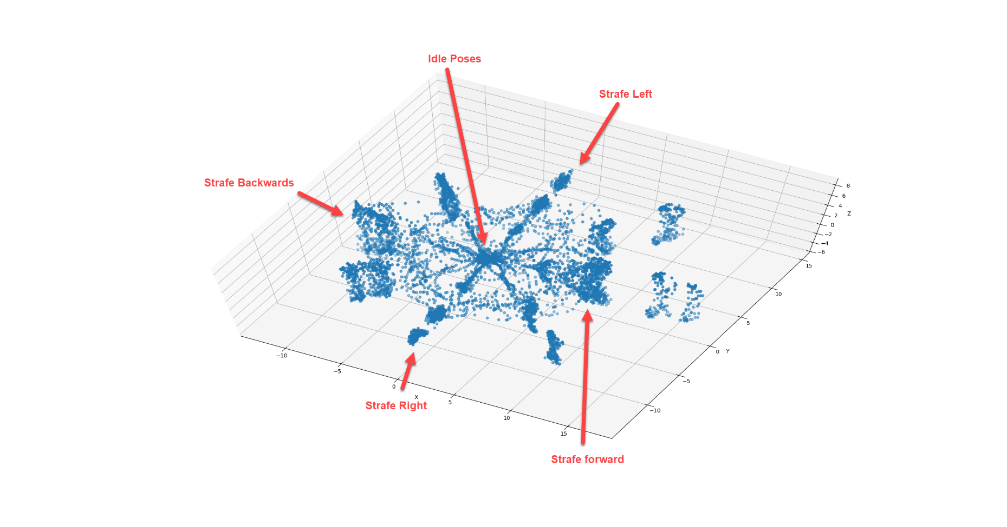
Look at the data
Notes:
If character is moving right, we only want to search moving right poses.
There’s no point to search idle poses, moving backward, forward poses.

Slide 32
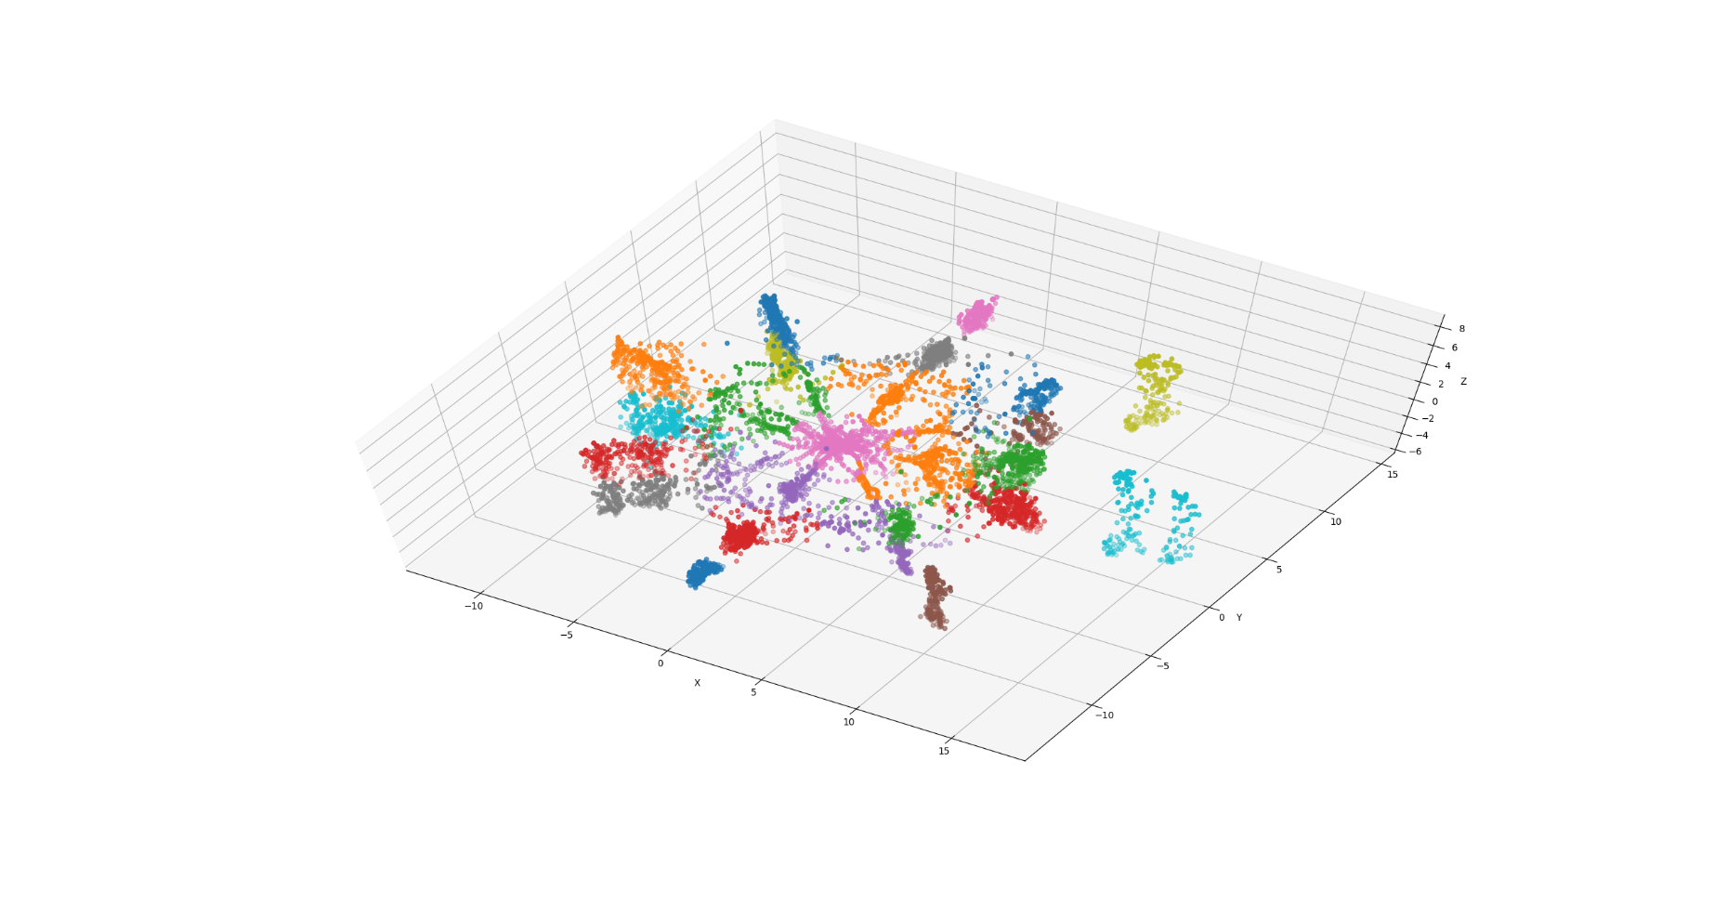
Cluster the data (KMean) offline
Notes:
Cluster the data using KMean.
Then build a bounding sphere for each cluste’s mean.

Slide 33
Run time code
Given a desired trajectory, it’s also an high dimension point.
run time code first find this “point” is inside which cluster bounding sphere.
Only search best match pose in those intersecting clusters.
Notes:
The key is to reduce search space.

Slide 34
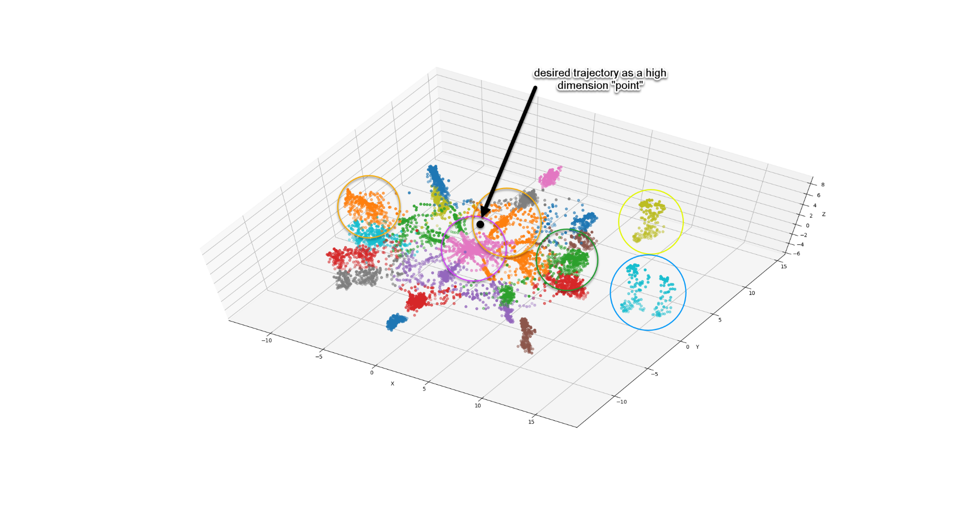
Run time code

Slide 35
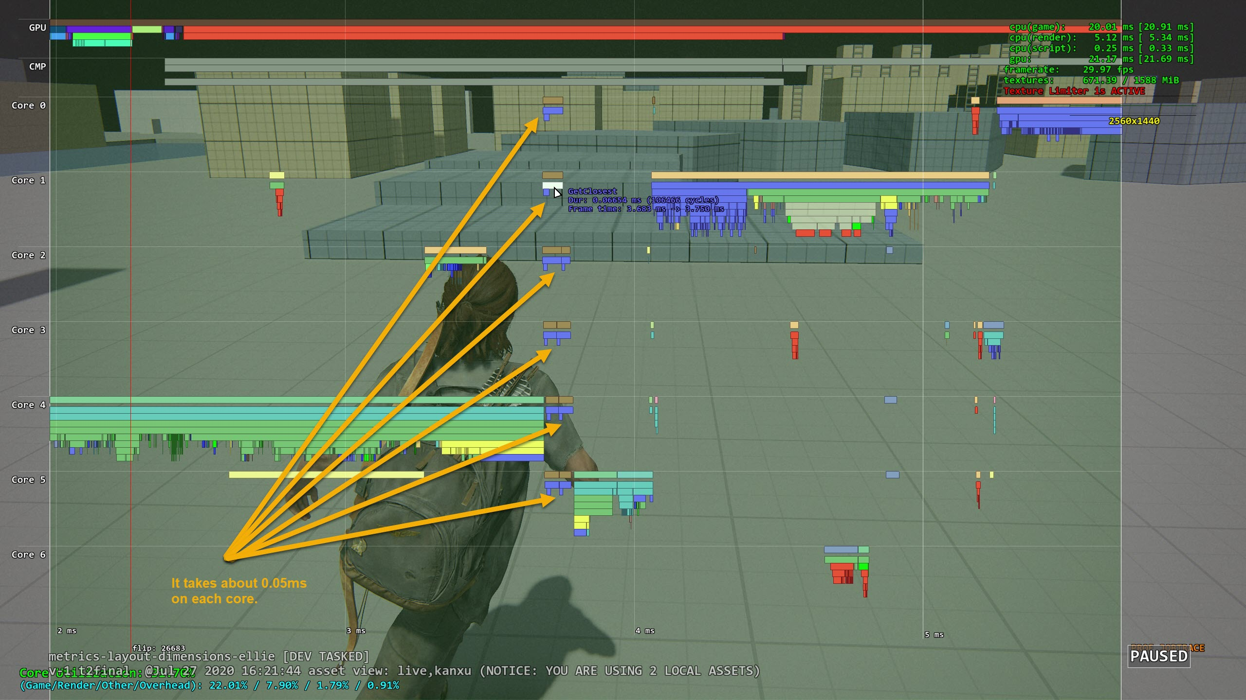
Result

Slide 36
Another optimization idea
Clustering poses using multiple dimension Kd-Tree
Maybe use PCA to reduce dimension first.

Slide 37
What else?
Character Movement driven by root motion or procedurally?
Procedural character rotation.
Scale animation playback speed to match desired speed.
Foot pinning IK.
Notes:
TLOU2 uses root motion to drive character’s movement. Some other games (especially online FPS), it can use procedural trajectory to move the character. And animation just tries to do best match.
Need procedurally rotate the character align to match the desired trajectory.
Foot pinning IK is very important, it fixes the foot sliding during procedural rotation and animation blending. We need evaluate feet speed and apply IK. A simple 2 bone IK will do the job.

Slide 38
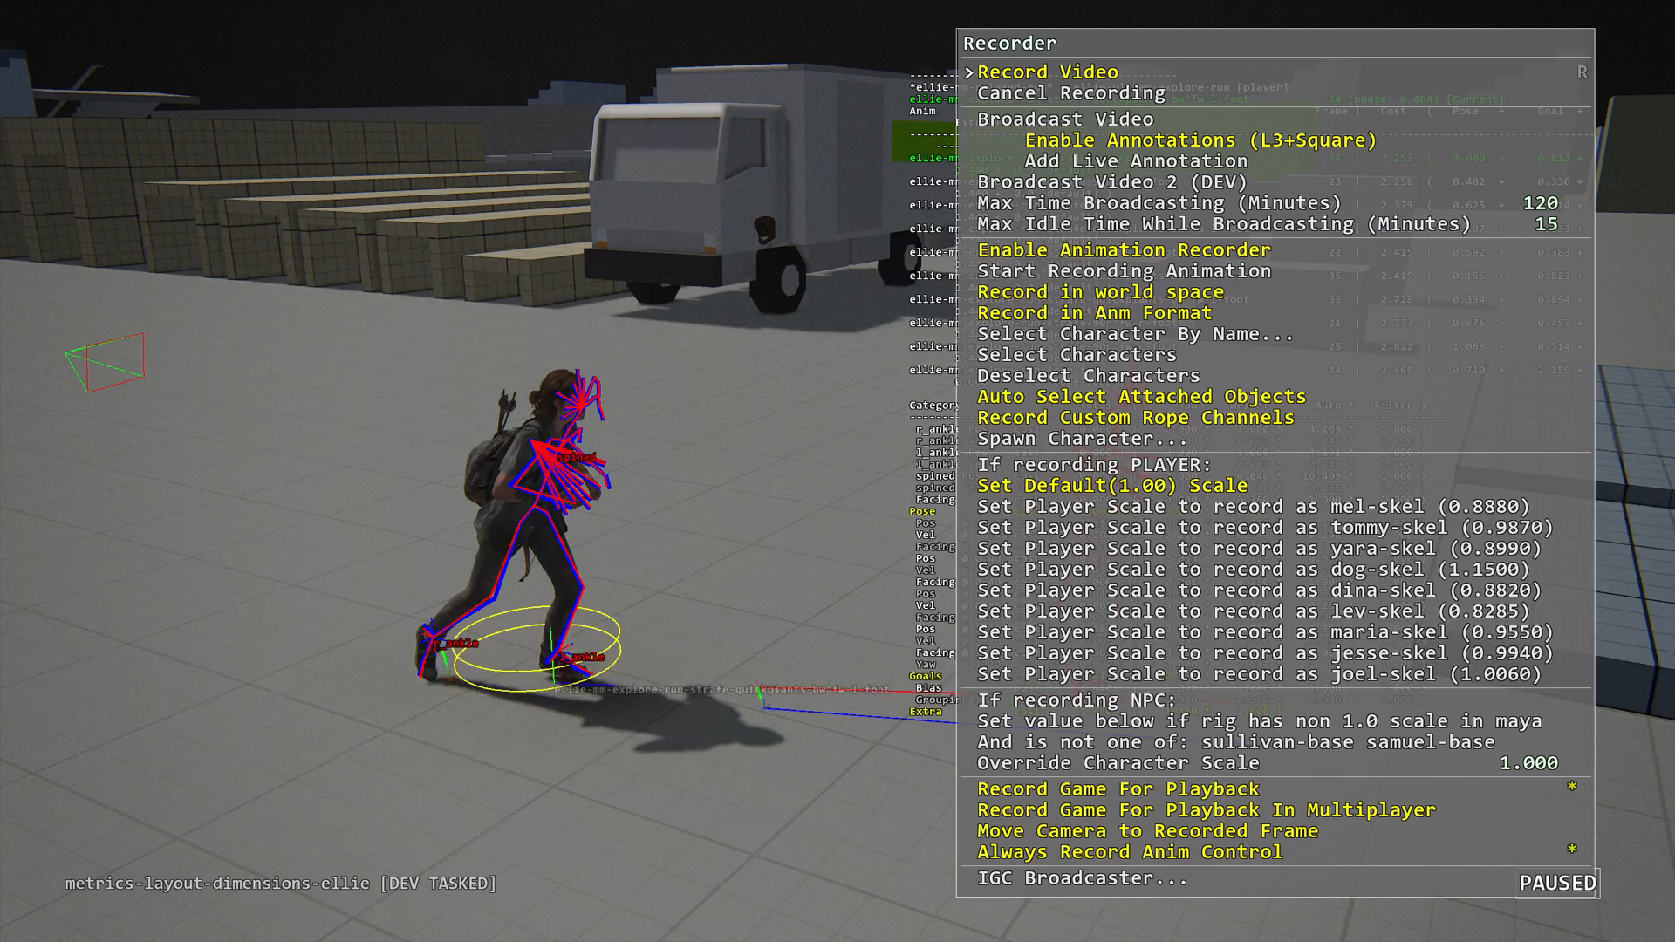
Debugger

Slide 39
How about other animation?
Motion matching suits locomotion naturally
The principle is applicable to other types of movement:
Melee
Hit reactions
Can be pose matching only
Consideration to use motion matching:
If it’s a core gameplay system?
Code complexity

Slide 40
Cons
Mirroring doubles CPU costs
Need a lot tweaking to get specific anim to play
Need extra work to sync with layers
Notes:
Overall we think MM pros is much bigger than Cons, so it’s worth it.

Slide 41
How does MM affect programmers?
Save a lot time coding locomotion state machine
Need good in game visualization debugger to explain why this pose is selected

Slide 42
How does MM affect animators?
Animation Clips are recommended:
Clips can remove redundant data
Need time to tweak pose weights and trajectory weights
No markup needed

Slide 43
Conclusion
MM is data-driven approach which handles transition, which produces better quality.
Motion matching will be next-gen animation standard.
MM means mentality shift to animators. They need take extra steps to manage “MM sets”.
Reference: Michael Buttner [Motion Matching - The Road to Next Gen Animation]

Slide 44
Q&A

